Slide 1
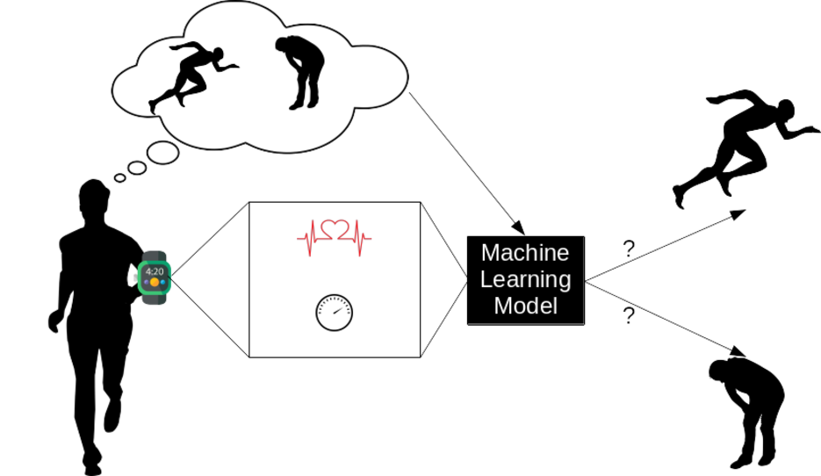
HEALTH ANALYSIS BY SMARTWATCH USING MACHINE LEARNING

Slide 2
GROUP MEMBER
Ravi Kumar Byahut 11900319063
Amit Kumar 11900319032
Saikat Sarkar 11900319062
Soni Kumari 11900320037
Under the guidance of
Dr. Sudip Ghosh
ECE,SIT

Slide 3
OBJECTIVE
Early detection of health problems using machine learning
Enhancing preventive care and quality of life with ML in healthcare
More accurate diagnoses and treatment plans for better patient outcomes
Leveraging smartwatches for efficient monitoring
Fast prediction of results for quick action and intervention

Slide 4
PROJECT DESCRIPTION
In this project, we aim to detect certain health problems using machine learning algorithms, based on data collected from smartwatches. We focus on specific health issues that can be detected through parameters such as heart rate, SpO2 levels, and stress levels. Our goal is to provide an efficient early detection system for these health issues, which can help improve preventive care and enhance the quality of life for individuals.

Slide 5
Work Done
Collected the reading such as Heart Beat,Spo2 Level, Stress Level from smartwatch and updated the data in excel sheet.
Converted the excel sheet in Csv format and used this dataset In machine learning.
Performed the following steps.
Collected the data from smartwatch
Loaded the csv file in jupyter notebook
Converted the data into csv file
Feature Engineering
Selected Appropriate ML Model
Fit Model On Training Data
Normal Condition Or Not
Prediction Made
Generate Algorithm Metrics
Derive Predictions on test data

Slide 6
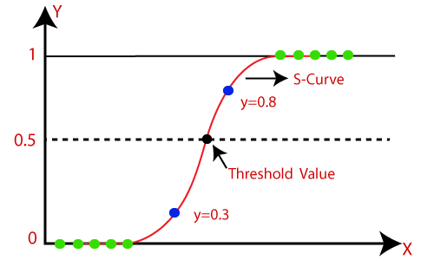
Model Used: Logistic Regression
1) It is a supervised learning algorithm used for classification. 2) Logistic regression is a classification algorithm used to assign observations to a discrete set of classes. 3) It is used when the dependent variable (target) is categorical. 4) Logistic regression transforms its output using the logistic or sigmoid function to return a probability value which can then be mapped to two or more discrete classes.

Slide 7
Future Scope
Machine learning will change health care within a few years.
In future ML and AI will transform health care, but quality ML and AI decision support systems (DSS) Should Require to address the problems faced by patients and physicians in effective diagnosis.
It will easily reachable the people in remote area where the availability of doctor is not sufficient.
It will be cheaper and Time efficient.
It will be easily accessible for everyone.
The algorithm could also suggest possible treatment options based on the latest relevant literature. Machine learning can process large amounts of patient data beyond the scope of human capability, then reliably convert that analysis into medical insights that help clinicians plan and deliver care

Slide 8
Thank You

